Slide 1
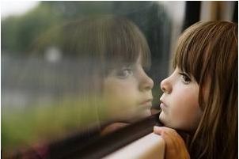
How can we communicate feelings?

Slide 2
Are you talking clearly?
How do you communicate feelings that will not escalate conflict?
Blame game
You message
Describe feelings
I message
Different impacts
You message implies
I message implies
Notes:
Blame game: Friend devulges a secret or spreading gossip
I message – I felt angry when you told people my secret
You message implies judging, blaming infer bad person
I message implies needs and concerns

Slide 3
What are the parts of an I Message?
I feel … (state feeling)
When you … (describe other person’s behavior)
Because … (describe the consequences of the other person’s behavior
And I want … (state what would make the situation better for you)
Notes:
Eg. I feel frustrated when you borrow my books and don’t return them on time because I can’t finish my homework. I need to count on getting them back at the time we agreed.
Younger students might leave out because.

Slide 4
How you say it
People communicate through more than words
Tone
Loudness
How close you stand
Gestures

Slide 5
But what if I am angry?
Difficult in midst of intense feelings
Takes time and practice for I Message to become a natural response to conflict
How can you help students develop this attitude?

